Slide 1
answer

Slide 2
1.Given a relation R(A,B,C,D) and functional dependency set FD ={AB->D,B->C}, determine whether the relation is in a 2NF? and determine the table decomposed.
1) R(A,B,C,D)
AB->D,B->C
A,B PRIME KEYS ATR CK
C,D NON PRIME KEYS
(AB)= {ABCD) CK
R1 (ABD)
R2 (B,C)

Slide 3
2.Find the minimal cover of R(W X Y Z) FD: x->w wz->xy y->wxz

Slide 4
3.Check whether following schedule is conflict serializable or not? If it is not conflict serializability then find the serializability order.
T1 | T2 | T3
R(A)
 | R(B) | R(B)
 | W(B)
STEp 1: We will read from top to bottom, and build a precedence graph for conflicting entries
Fig. 6.5 Precedence graph
Step 2: As there is no cycle in the precedence graph, the given sequence la conflict serializable. Hence we can convert this non serial schedule to serial schedule. For that purpose we will follow these steps to find the serializable order.
Step 3: A serializability order of the transactions can be obtained by finding a linear order consistent with the partial order of the precedence graph. This process is called topological sorting.
Step 4: Find the vertex which has no incoming edge which is TI. Finally find the we having no outgoing edge which is T2. So in between them is T3. Hence the order will be T1-13-12
T1
T2
W(A) |  | W(A)
 | R(A)
 | W(A)
T3

Slide 5
4.Consider a relation R(ABC) with the following FD: A->B,B->C and C->A . What is the normal form of R ?
Solution:Step 1: We will find the candidate key
(A)+ = (ABC)=R
(B)+ = IABC)=R
(C)+= (ABC)=R
Hence A, B and C all are candidate keysPrime attributes= (A,B,C)Non prime attribute)
Step 2: For R being in BCNF for X->Y the X should be candidate key or super key.
From above FDs
Consider A->B in which A is a candidate key or super key. Condition for BCNF is satisfied
Consider B->C in which B is a candidate key or super key. Condition for BCNF is satisfied.
Consider CA in which Cis a candidate key or super key. Condition for BCNF is satisfied.This shows that the given relation R is in BCNF.

Slide 6
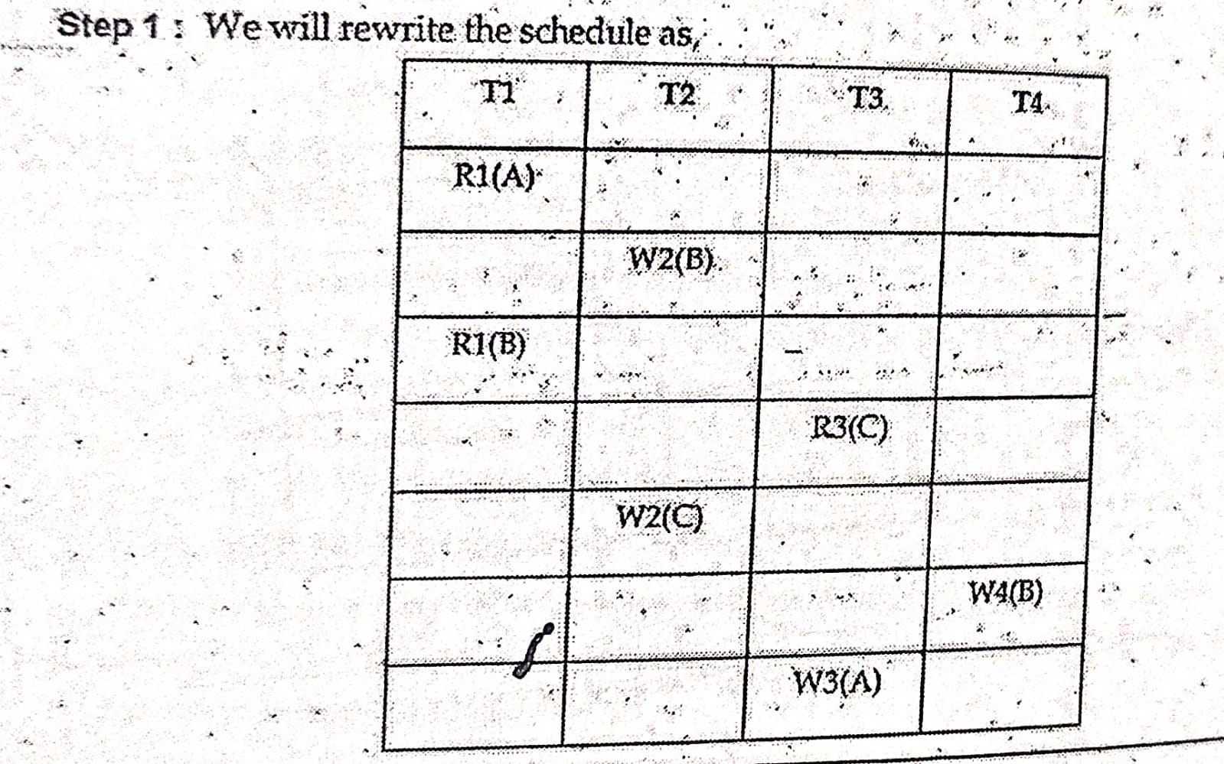
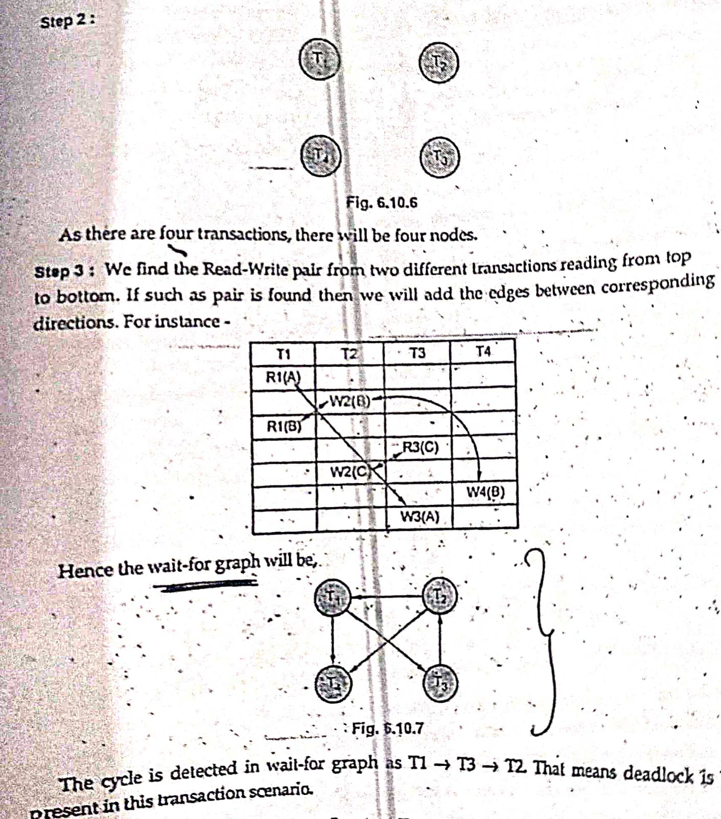
5.Consider the following sequence of action listed in order they are submitted to DBMS sequences S1: R1(A)W2(B);R1(B);R3(C);W2(C);W4(B);W3(A); Draw a wait for a graph in case of a deadlock situation.

Slide 7
6.Consider the Relation (A C D E H) having two sets of functional dependency F= { A->C,AC->D,E->AD,E->H} and G={A->CD,E->AH}
G:A->CD
E->AH
(A)+=ACD
(E)++EADHC
G<=F
F=G
R(ACDEH)
F:A->C AC-> D
E->AD
E->H
A+ ACD
(AC)+-> ACD
(E)+ - EAHCD
F<=G

Slide 8
7.Given FD’s for a relation R(A,B,C,D,E,F) .Find the closure of FD said by applying Armstrong’s Axioms A->B , A->C , CD->E , CD-> F , B->E
Solution
Step 1: A-> gives A attribute itself by reflexivity. It is called trivial production.
A-> Band A-> C, Hence by union rule
A-> B and B-> E, Hence by transitivity rule A -> E
(A)+=(A,B,C,E)
Step 2: B gives B itself And B-> E.
(B)+= (B,E)c
Step 3: CD-> gives CD itself.
It is trivial.CDE, CD->F, Hence by union rule CD -> EF
(CD+)=(C,D,E,F)
So by omitting trivial productions, we get
F+=(A-> BC, A->E, B-> E, CD-> EF)

